Slide 1

Terrier Cyber Quest 2024 Datathon : Track 3
Territorial Army Cyber Challenge: Innovating for the Future of Defense
Prototype Title-THE DEEPFAKE SLAYER
Team Name: bornpresident
Team Member 1 Name: Vishal Chand email id: vishalchand20016@gmail.com Mobile No: +91-7717363942 | Team Member Name 2: Name: Aditya Singh email id: adsingh837@gmail.com Mobile No:+91-9838980461

Slide 2
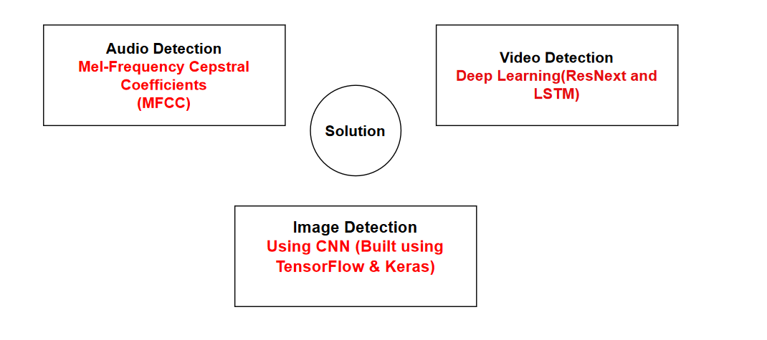
THE DEEPFAKE SLAYER

Slide 3
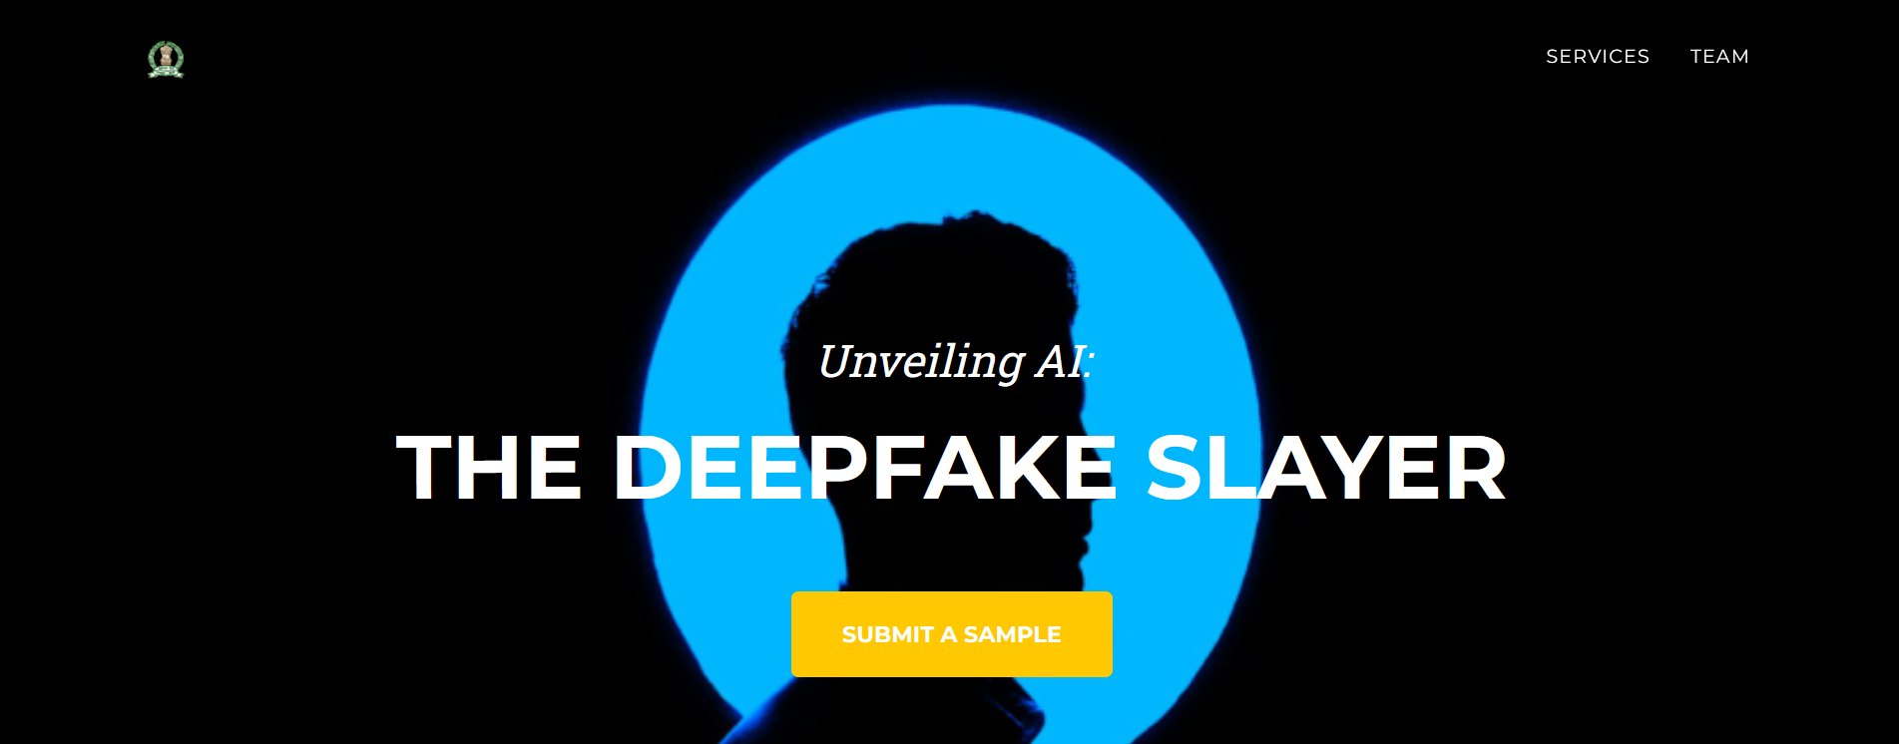
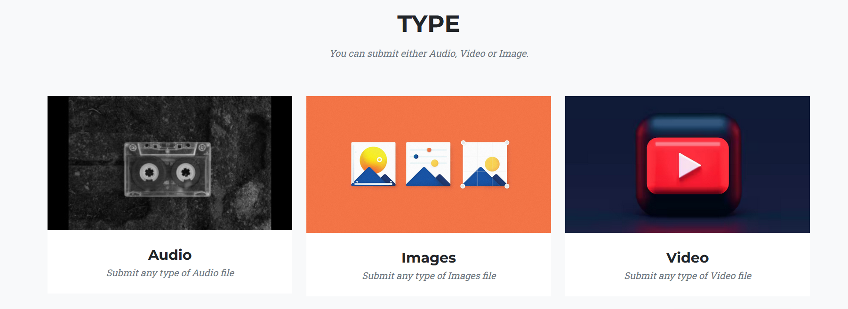
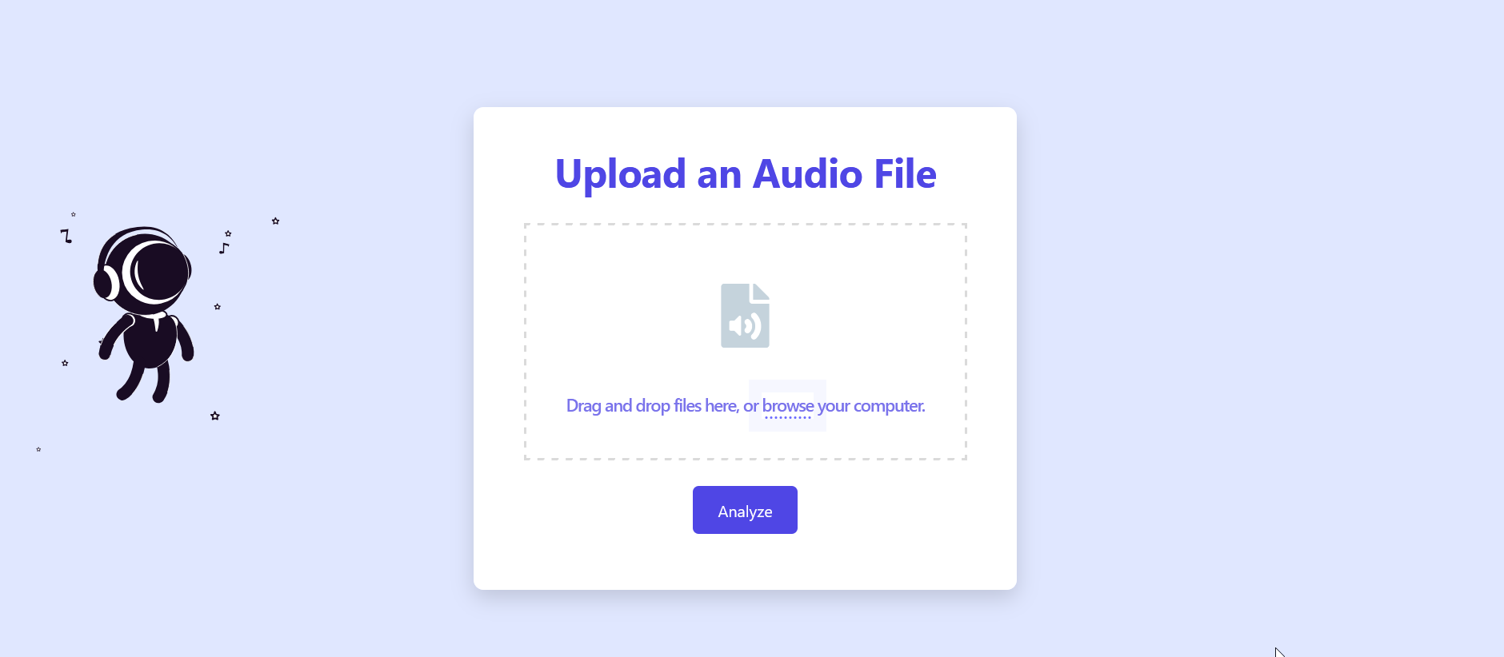
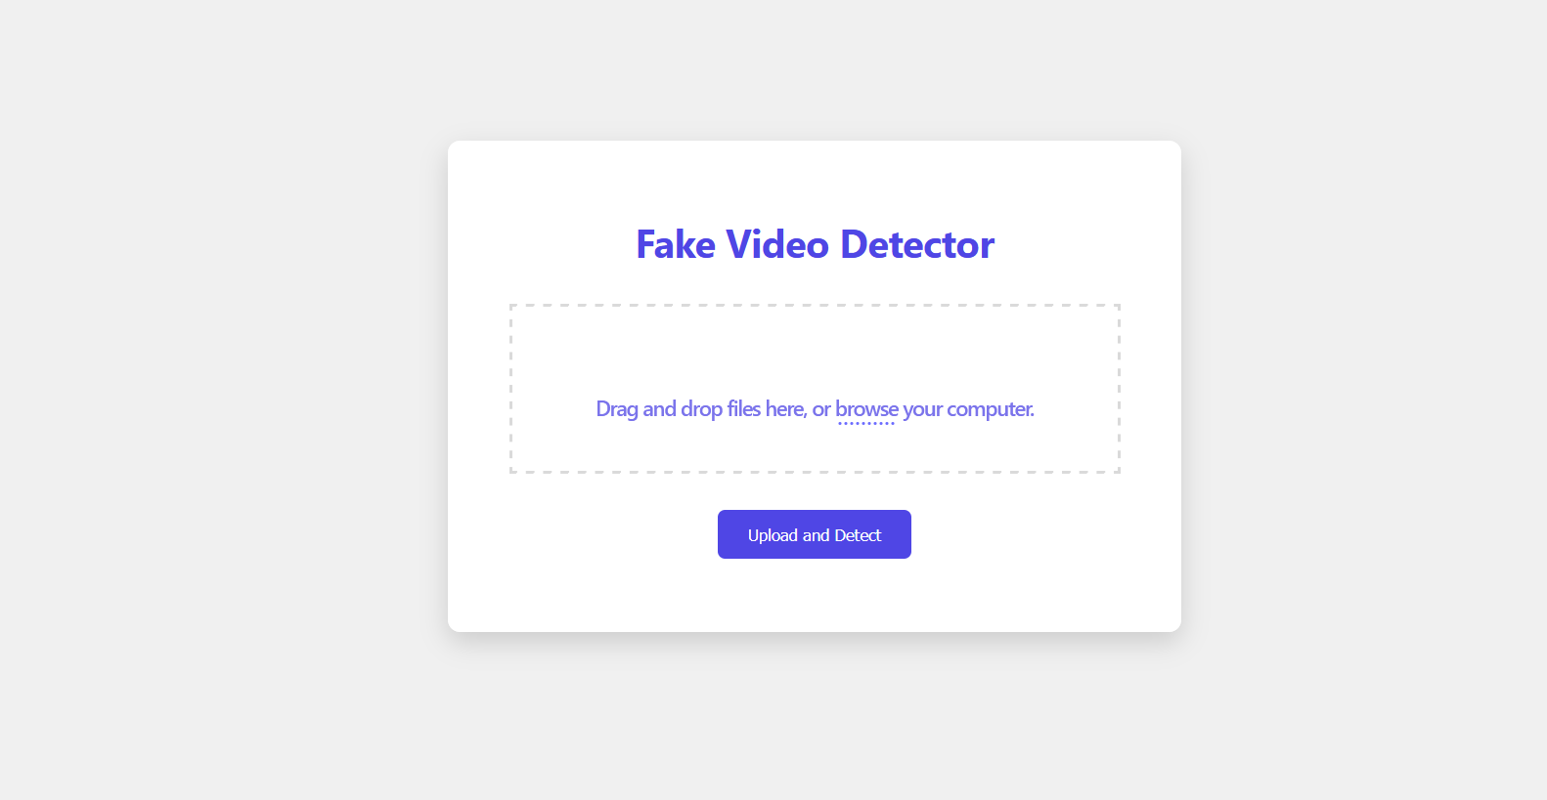
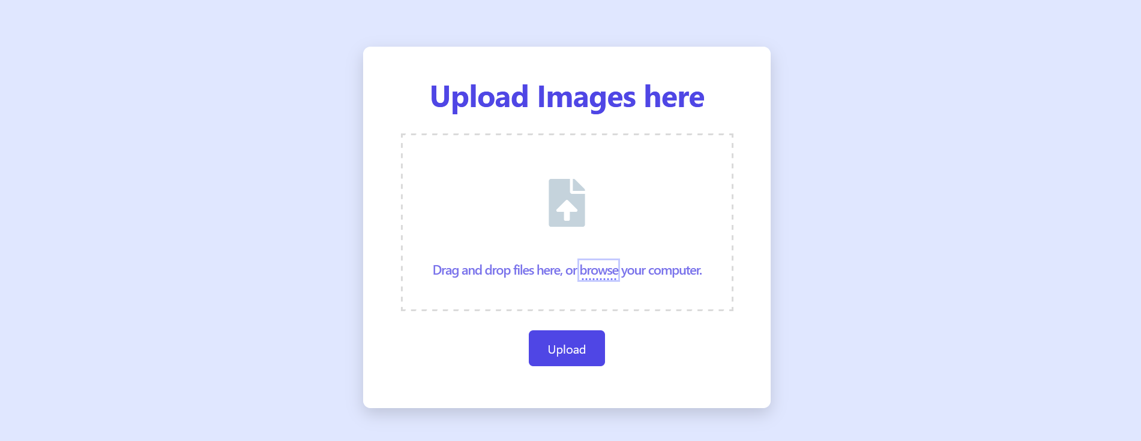

Slide 4
Innovation & Uniqueness
Supports various file types
Reporting feature to Indian law enforcement agencies.
URL submission
Feedback loop for automated learning.
Informative dashboards for visual analytics.
AI/ML Algorithm used
Audio detection: MFCC, SVM, Random Forest, MLP, XGBoost.
Image detection: CNN using TensorFlow and Keras.
Video detection: CNN & RNN
Technologies used
Programming languages: Python, JavaScript
Machine learning libraires: PyTorch,TensorFlow, Keras, scikit-learn, NumPy, pandas, Matplotlib,etc
Hardware: CPU/GPU-enabled systems for model training interference

Slide 5
Feasibility, Challenges, and Strategies
Feasibility:
Audio Detection: The project uses MFCC (Mel-frequency cepstral coefficients) features extracted from audio files and a Support Vector Machine (SVM) classifier to differentiate between genuine and deepfake audio.
Video Detection: ResNext & LSTM architectures suited for deepfake video analysis.
Image Detection: CNN (TensorFlow/Keras) ideal for image manipulation detection.
Challenges & Risks:
Data Quality: Difficulty in sourcing large, clean, labeled deepfake datasets.
Generalization: Models might struggle with unseen deepfakes.
Real-time Performance: Potential latency for large video files.
Model Complexity: High computational requirements for complex models.
Strategies to Overcome:
Data Quality: Leverage synthetic data generation & data augmentation.
Generalization: Use transfer learning to adapt to new datasets.
Real-time Performance: Optimize models with lightweight/quantized versions.
Model Complexity: Utilize cloud computing & hardware accelerators (GPUs/TPUs).

Slide 6
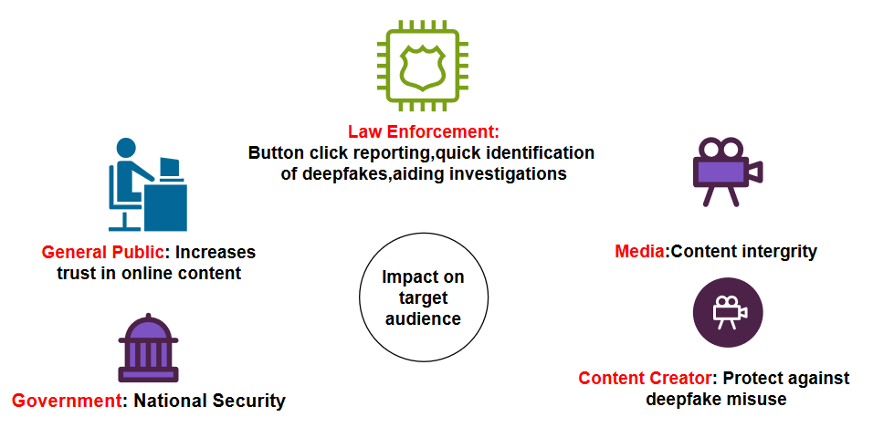
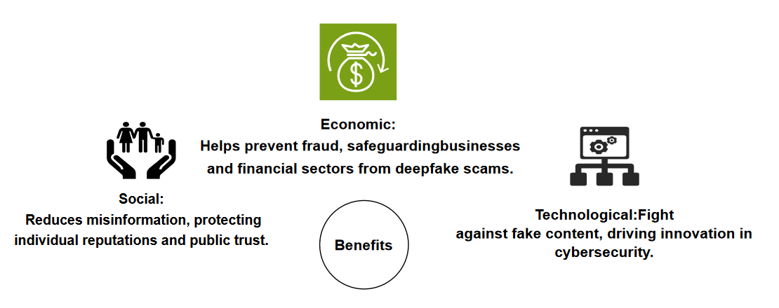
Impact & Benefits

Slide 7
RESEARCH AND REFERENCES
https://github.com/abhijitjadhav1998/Deepfake_detection_using_deep_learning
https://github.com/talreiss/factor
https://abhijithjadhav.medium.com/deepfake-video-detection-using-long-short-term-memory-df3674f83ecc
https://arxiv.org/abs/2107.14480
https://ieeexplore.ieee.org/stamp/stamp.jsp?tp=&arnumber=9996362
Data-set references :
https://www.kaggle.com/datasets/manjilkarki/deepfake-and-real-images
https://github.com/yuezunli/celeb-deepfakeforensics
https://www.kaggle.com/c/deepfake-detection-challenge/data
https://github.com/ondyari/FaceForensics

